Slide 1
Fog Mediated Data Sharing for IoT platforms
Sponsor - CMU CyLab, Qarnot Computing Points of contact - Yuan Tian, Emmanuel Owusu Faculty Advisor - Patrick Tague Team - Aditya Subrahmanyan, Sumana Potturu and Yuehao Yuan

Slide 2
Project Background
Problem statement:
“Develop, deploy and evaluate a fog-mediated data sharing service without compromising on both the user’s privacy and the quality/accuracy of the action on the data.”

Slide 3
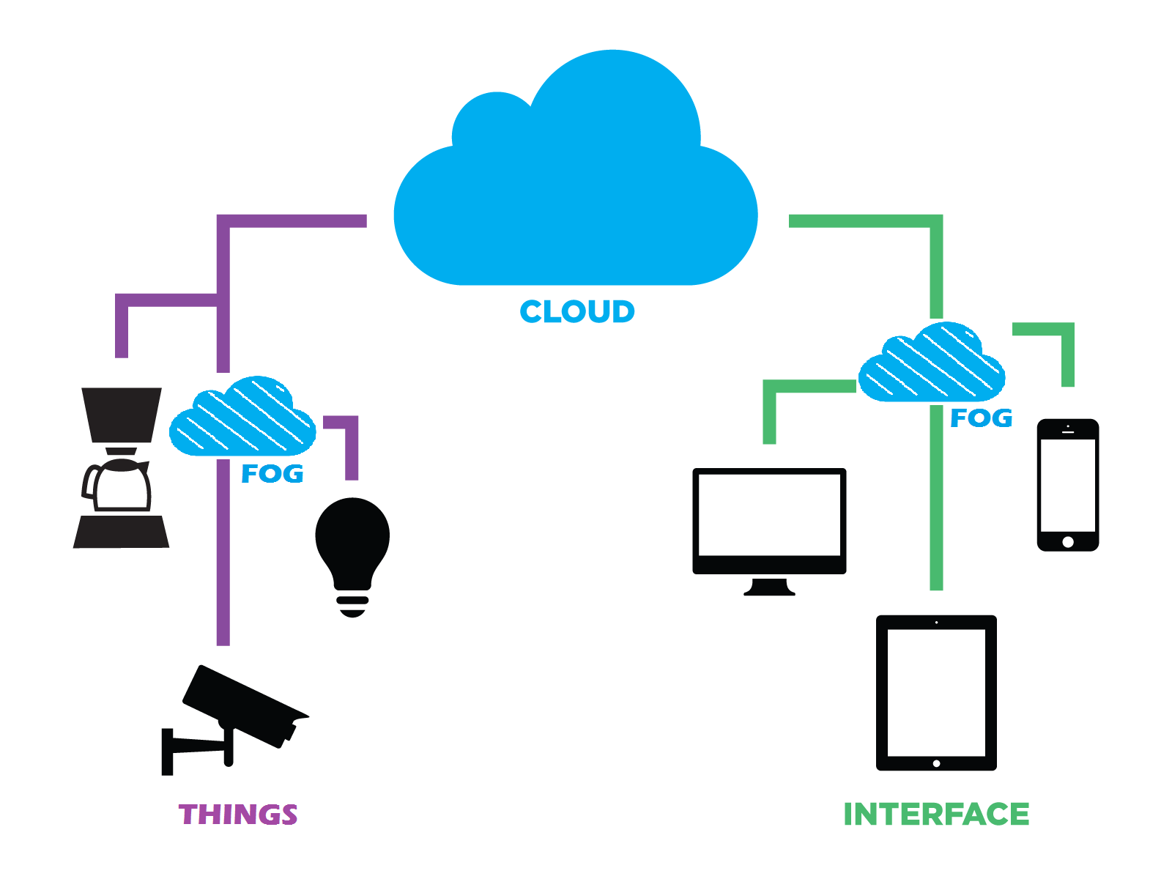
Breaking down the problem
Fog computing
Proposed by Cisco.
Paradigm that extends cloud computing and its services to the edge of the network (closer to the end user).
Ex: Wireless sensor networks, smart homes, SDN, etc.
Routers, industrial controllers, smart control devices perform the computation, storage and networking.

Slide 4
Breaking down the problem (contd.)
Fog computing primarily extends the cloud computing idea to the world of Internet of Things (IoT).
IoT generates data at unprecedented rate and volume
Quick processing and inference required
Current cloud models cannot scale at this rate (~50 bn ‘things’)
Advantages of fog computing:
Efficient bandwidth usage
Minimized latency
Smaller subset of data handled

Slide 5
Breaking down the problem (contd.)
Generated data is periodically sent to the cloud service
Enables central application to analyze data set. Typically some kind of machine learning/deep learning models
Cloud can update fog nodes with better policies, rules, etc
Primary issue:
Data transfer to remote server could cause violation of privacy
No guarantee of anonymity for transmitted data
Filtered data could reduce accuracy of learning models on fog/cloud nodes

Slide 6
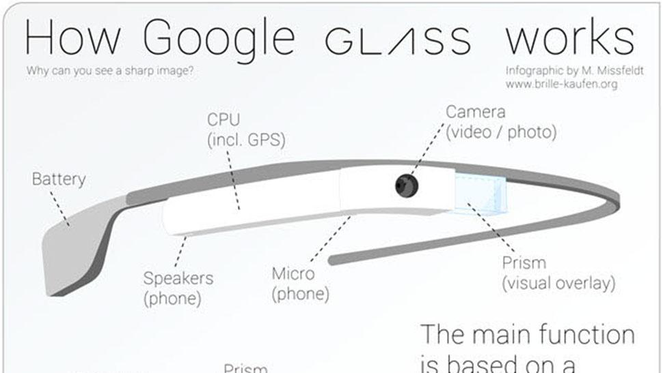
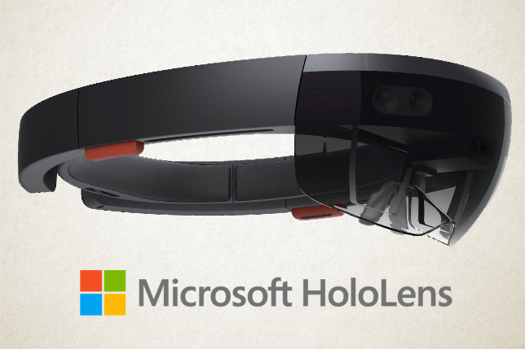
State of the Art
Augmented reality/Real-time video analytics

Slide 7
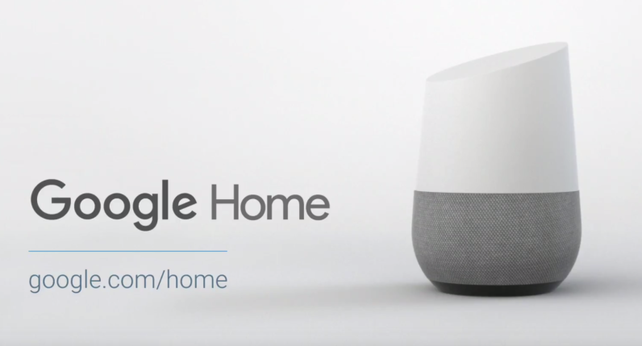
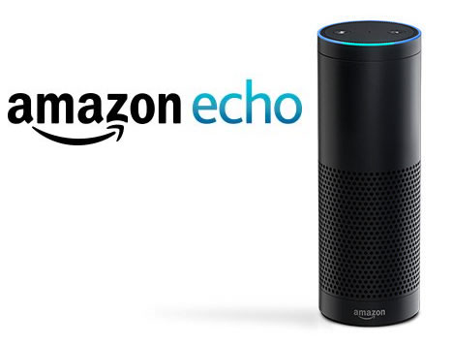
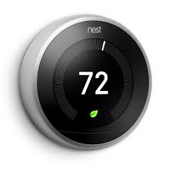
State of the Art (contd.)
Smart speaker/home devices

Slide 8
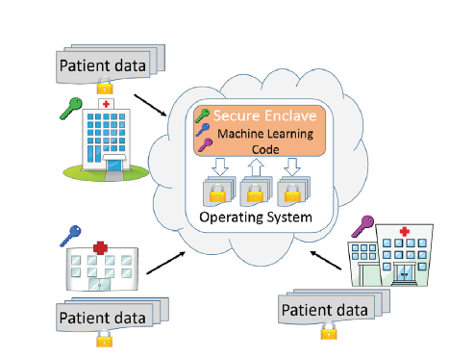
State of the Art (contd.)
Oblivious Multi-Party Machine Learning on Trusted Processors
Trusted hardware to provide end-to-end
Security
Multiple parties run machine learning
algorithm on their respective data set to
perform a task
Data oblivious machine learning algorithm
Computation becomes very slow

Slide 9
State of the Art (contd.)
Privacy preserving deep learning
Local training involving no sharing of input data set
All the parties jointly learn the neural network model by using Distributed selective SGD protocol
Gradient sharing could lead to indirect data leakage
Could result in lower accuracy rate
Deep learning with differential privacy
Noise is added to the gradient at every step of SGD to protect privacy
Checks for privacy loss at each step
Large information losses in some cases

Slide 10
What’s the gap
Latency
Back and forth sharing of data with Cloud
Delays could be life threatening for time critical applications
Eg. vehicle to vehicle communication, patient acre
Bandwidth
IoT generates large volume of data at very high rate resulting in requiring high bandwidth
Network Availability
Network might not be available at all times
Key concern for time critical applications
improve efficiency and reduce the amount of data that needs to be transported to the cloud for data processing, analysis and storage.
Reduce of Cloud Systems
decreased time to action; reduced costs, infrastructure and bandwidth
This greatly decreases network strain and time to action, and organizations don’t need to increase their physical infrastructure and network capacity
Location Awareness

Slide 11
What’s the gap (contd.)
Security and Privacy
Accurate data needs to be shared
Requires users to share private data for training ML models
Users have no control over the learning objectives
Processing Burden
Cloud models are not designed for the volume, variety, and velocity of data that IoT generates
Large volumes of unnecessary data is sent

Slide 12
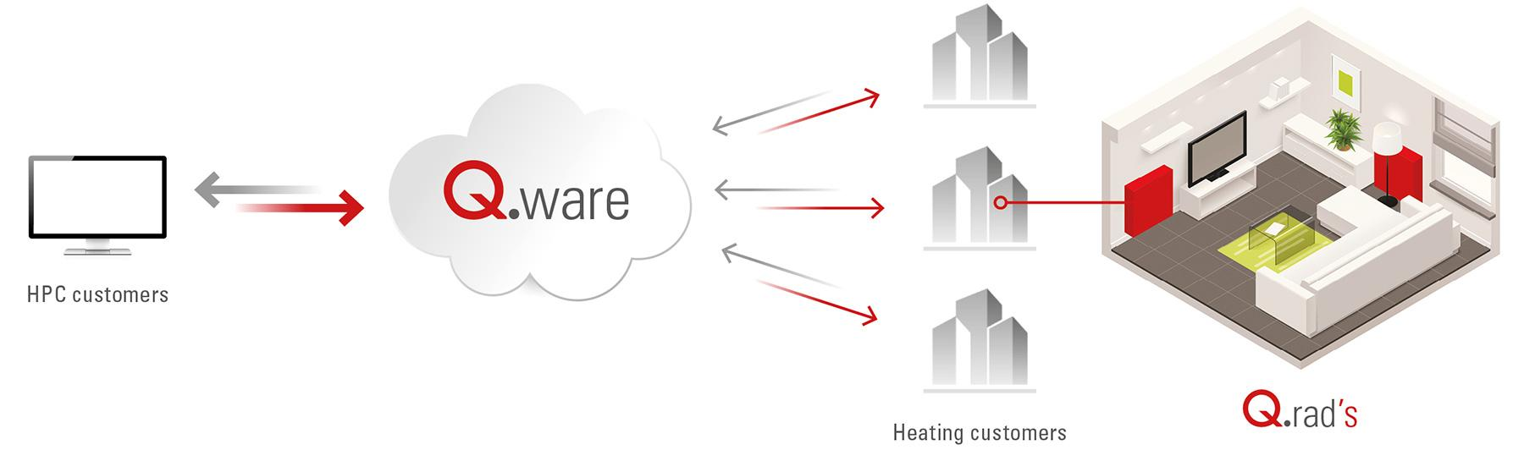
Preliminary Study (contd.)
Qarnot Computing - Q.rad

Slide 13
Preliminary Study
Libraries
Scikit-learn
Supports different machine learning algorithms
Eg. SVM and random forest
Cannot do deep learning
TensorFlow
Google's module for deep learning
Scikit-Image
collection of algorithms for image processing

Slide 14
Preliminary Study (contd.)
Hardware security
Trusted computing using processors like Intel SGX
Provide protected areas of execution (enclaves) which results in small TCB
Data integrity guaranteed even if OS and drivers are compromised

Slide 15
Proposed Methods
Build cloud service to mediate data
Test machine learning algorithm
Evaluation

Slide 16
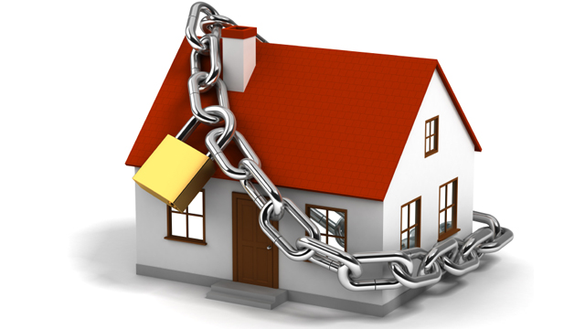


Build Cloud Service
1. Find application use case, define tasks for each type of nodes
2. Design and implement cloud service for data processing
Home Security
Elderly Care
Infant Monitoring

Slide 17
Build Cloud Service (contd.)
3. Add trusted computing feature
TPM-like functionality: Intel SGX(Software Guard Extensions), ARM w/ TPM
4. Protect the communication security among different nodes
Encryption, authentication, etc.

Slide 18


Test Machine Learning Algorithm
Test machine learning algorithm on public cloud, e.g: AWS
2. Test machine learning algorithm on fog mediation nodes

Slide 19
Test Machine Learning Algorithm(contd.)
3. Privacy-preserving machine learning models:
Partition Model（Deep learning: deploy computation tasks indipendently）
Inference Model (SVM: Split model training and model inference)
Parameter Model (Gradient descent: share tuning parameters)
4. Questions to answer:
What should be shared in each machine learning algorithm?
How much more accuracy can we get?
What is the privacy benefit?

Slide 20
Evaluation
1. Performance overhead:
Compare fog computing to data center (only mediation)
Compare secure fog computing to data center(mediation + trusted computing)
2. Privacy
3. Accuracy of machine learning

Slide 21
Tentative Schedule
Week 1-2: Get familiar with the platform and problem
Week 3: Experiment with machine learning algorithms
Week 4-5: Build the basic cloud service
Week 6-7: Build the trusted computing feature
Week 8-10: More on the machine learning algorithms
Week 11-12: Evaluations
Week 13-14: Writing

Slide 22
References
Fog computing - https://www.cisco.com/c/dam/en_us/solutions/trends/iot/docs/computing-overview.pdf
Qarnot Computing - http://www.qarnot-computing.com/green-computing
Intel SGX - https://software.intel.com/en-us/sgx
Images: https://www.images.google.com/
Yuan Tian, Emmanuel Owusu, “Fog Mediated Data Sharing in the Internet of Things”[proposal]
Abadi, Martín, et al., "Deep Learning with Differential Privacy", arXiv preprint arXiv:1607.00133 (2016).
Shokri, Reza, and Vitaly Shmatikov, "Privacy-preserving deep learning", Proceedings of the 22nd ACM SIGSAC Conference on Computer and Communications Security. ACM, 2015.
Scikit-learn: http://scikit-learn.org/stable/index.html
Tensorflow: https://www.tensorflow.org/
Scikit-image: http://scikit-image.org/

Slide 23

Questions?

